Slide 1

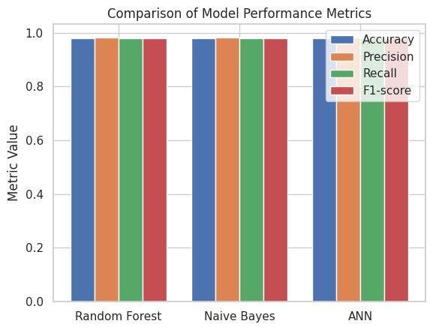
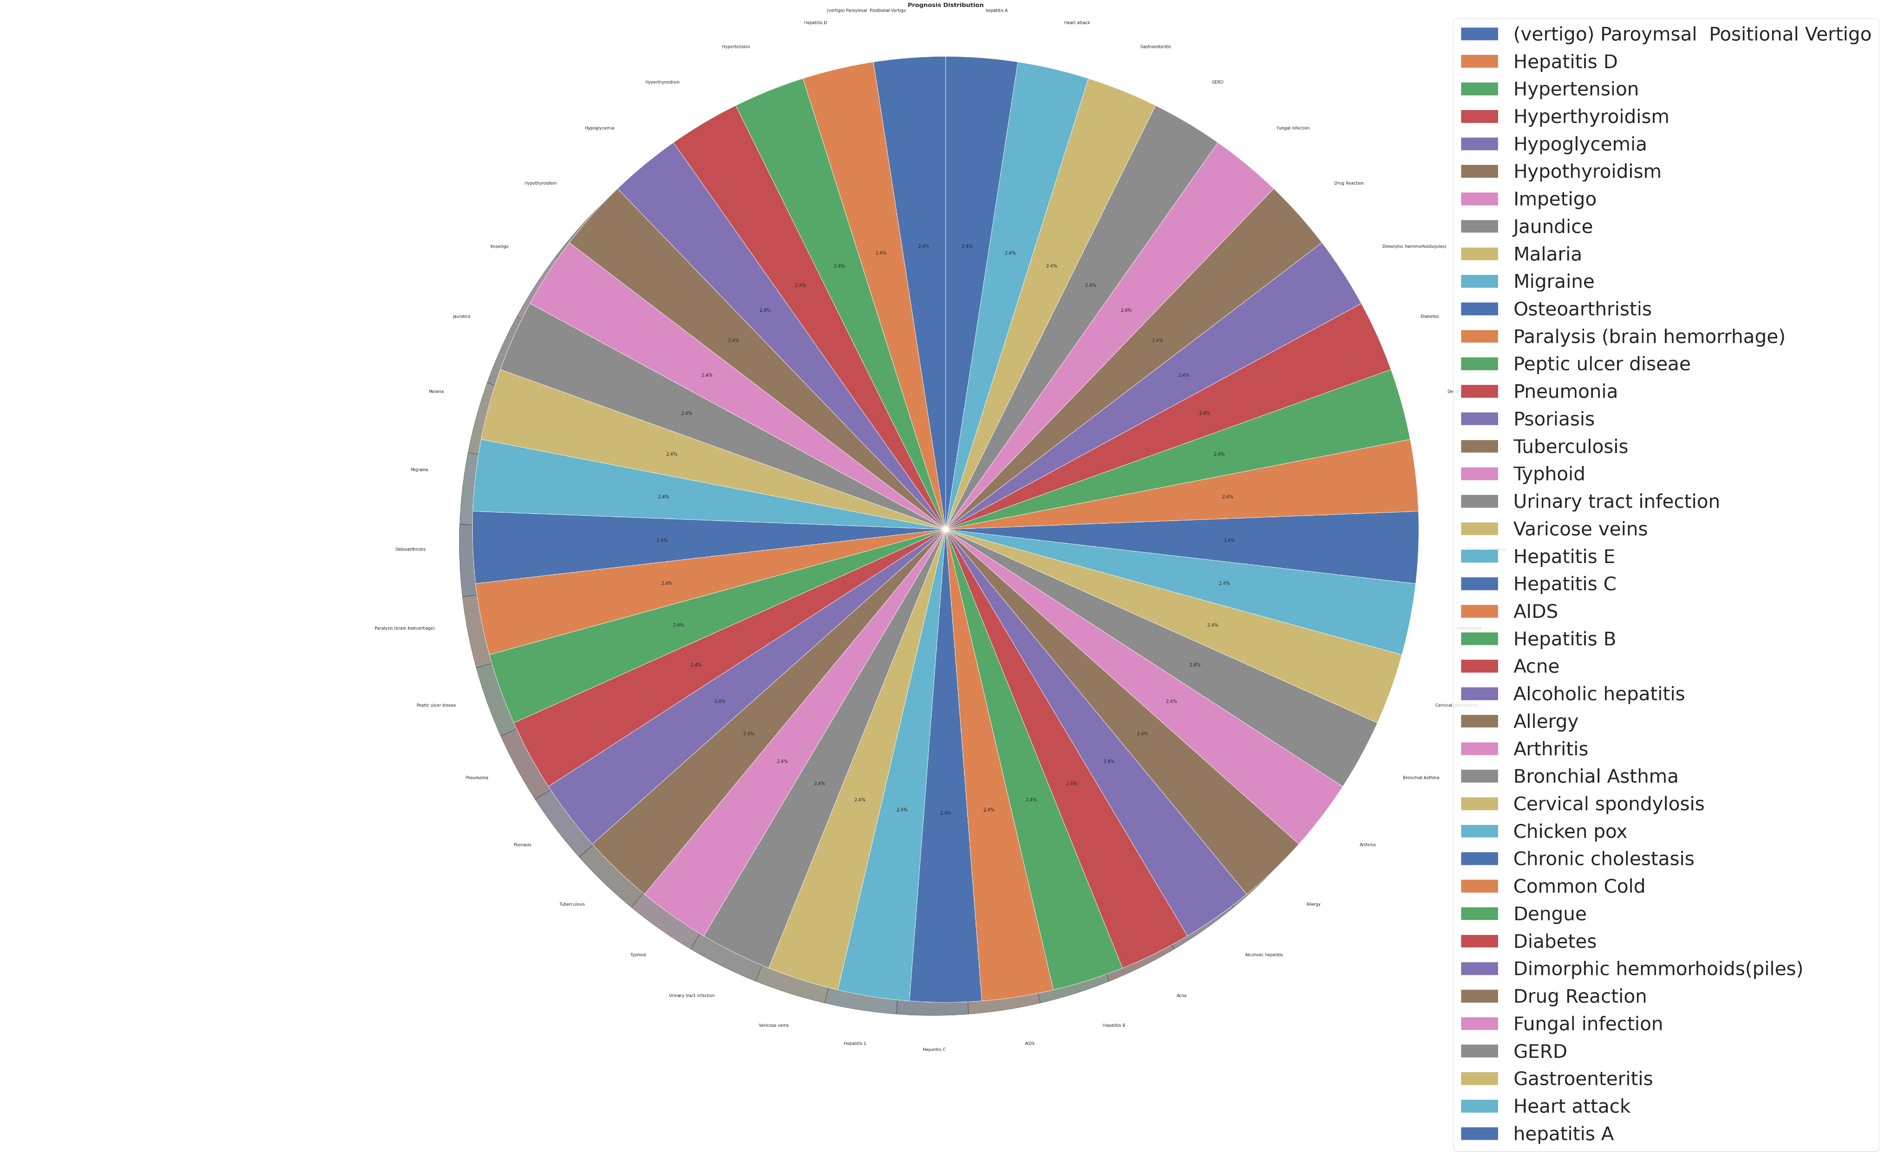

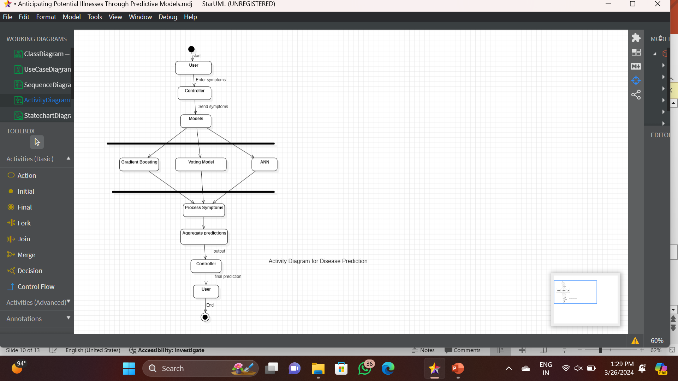
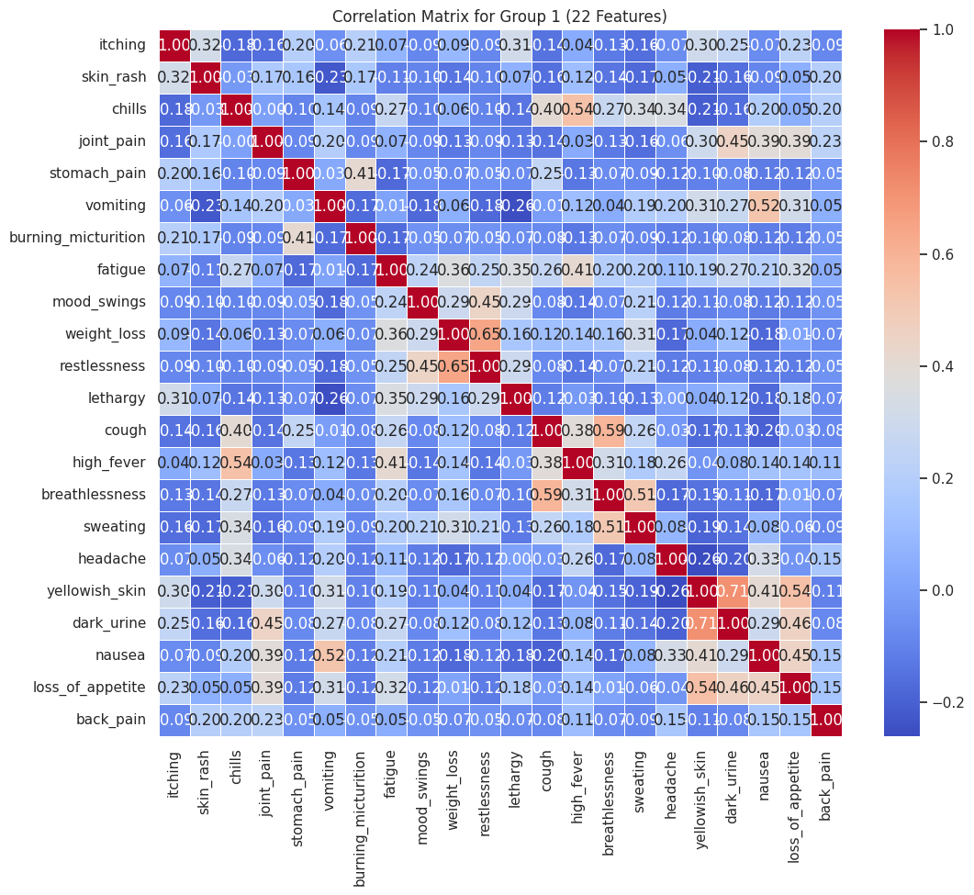
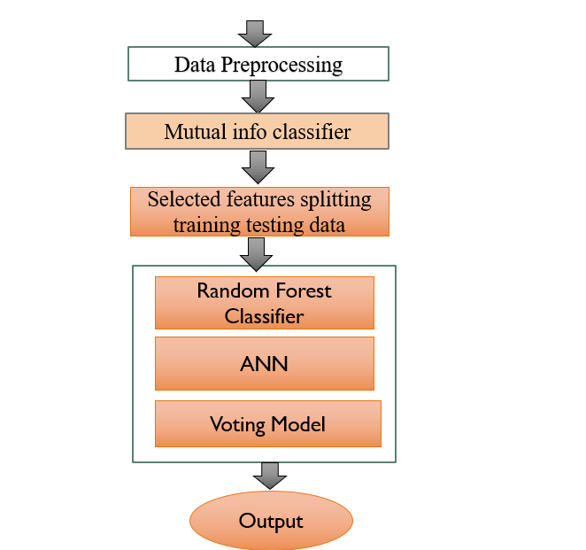
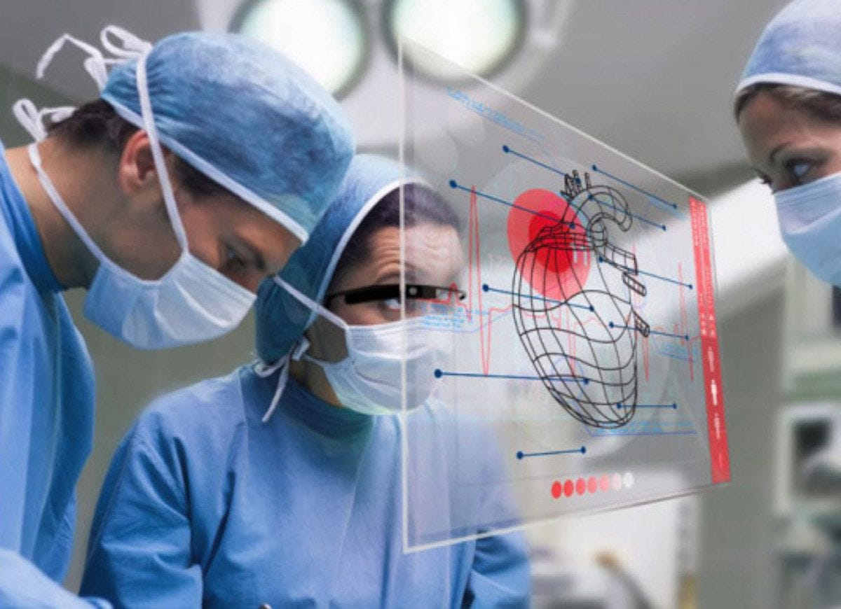
ANTICIPATING POTENTIAL ILLNESS THROUGH PREDICTIVE MODELS
Chidurala Ashwini
Polasani chaithrasri
Basani shashanka
Munja Sriharsha
Katha Sravani
SR UNIVERSITY
SCHOOL OF COMPUTER SCIENCE & ARTIFICIAL INTELLIGENCE
Abstract
Methodology
Results
This paper presents a novel machine learning method that uses 132 symptoms to forecast 42 diseases. We seek to address shortcomings in current disease prediction systems by integrating many data sources, including symptoms. With the use of sophisticated machine learning methods such as gradient boosting, voting models, and artificial neural networks (ANN), our model is able to predict the probability of many diseases, including neurological disorders, diabetes, cancer, and cardiovascular diseases. This system supports doctors and enhances healthcare outcomes by achieving high accuracy and robustness while also providing insightful information for managing and preventing disease.
.
Data collection: Compile illness labels and symptom information from reputable medical sources.
EDA and data preprocessing: manage missing values, scale numerical characteristics, encode categorical variables, and investigate distributions of data.
Using the Z-test to Select Features: Use statistical tests to determine the significance of the features and choose the most important ones.
Choosing the Best Features: To rank illness prediction features in order of priority, select the best features.
dividing data into sets for testing and training: Separate a bigger piece of the dataset for training and use it for model evaluation.
Using Gradient Boosting, ANN, and Naive Bayes: Train models and adjust hyperparameters accordingly.
Using the Voting Model and Plotting Outcomes: Build an ensemble model by aggregating forecasts, then compare the performance of the model against that of individual models.
Add your information, graphs and images to this section.
Fig:2.3 comparison of 3models performance using 4 metrices
Fig:2.1 count of different prognosis
Introduction
The above figure :2.1,pie chart describes how different prognosis(diseases) are occurred with respect to different symptomps. Each colour indicates unique prognosis and percentage of there occurrence.
Significant advancements in a number of sectors, including medical science, have resulted from the growing interest in machine learning and deep learning. The application of data analytics and cutting-edge technologies to disease prediction has become a critical area in healthcare, transforming preventive and early intervention strategies. Through the application of machine learning algorithms, big data analytics, and genetic profiling, health care providers can now predict an individual's probability of contracting a particular disease. This allows for preventative actions to reduce risks and improve public health outcomes in general. Disease prediction is at the vanguard of contemporary healthcare, providing revolutionary possibilities to improve population health outcomes, tailor medical interventions, and strengthen preventative care. The role of disease prediction is set to grow as medical technology develops and our knowledge of disease mechanisms expands.
Conclusion
From above results we conclude that In this work, the performance of three algorithms is thoroughly compared on a medical record, with each algorithm producing results with an accuracy of up to 98 percent. The primary distinction between our study and earlier research is that we used feature selection, narrowed the feature set to 50 symptoms, and achieved a 98 percent accuracy rate.
Fig:1.1
flow diagram of model implementation
Acknowledgements
hj
We would like to express our sincere gratitude to Dr. Sheshikala Martha madam Head- Computer Science And Engineering
Dr. Pramod kumar Poladi, Dr. Pappula Praveen Sir for their valuable guidance and wavering support throughout the completion of this project. Their expertise, insightful feedback, and encouragement have been instrumental in shaping the direction of our work and overcoming challenges along the way.
We are deeply thankful for Dr. Pramod kumar Poladi Sir’s mentorship and leadership, which have undoubtedly contributed to the successful completion of this project. His wisdom and guidance will continue to inspire us in our future endeavors.
Fig 2.2 correlation matrix
Above figure 2.2 is correlation matrix for selected features
Fig1.2
model implementation flow chart

